Slide 1
SERVICE DISCOVERY USING
ETCD, CONSUL, KUBERNETES

Slide 2
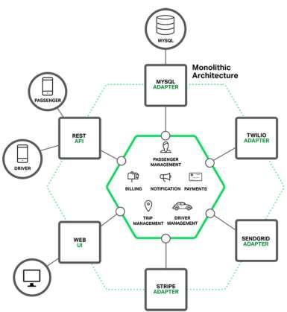
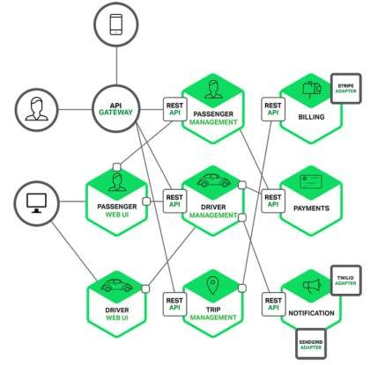
Sample Microservices Architecture
Monolith
Microservices
Image from https://www.nginx.com/blog/introduction-to-microservices/

Slide 3
What should Service Discovery provide?
Discovery - Services need to discover each other dynamically to get IP address and port detail to communicate with other services in the cluster.
Health check – Only healthy services should participate in handling traffic, unhealthy services need to be dynamically pruned out.
Load balancing – Traffic destined to a particular service should be dynamically load balanced to all instances providing the particular service.

Slide 4
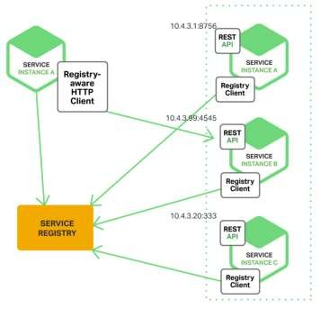
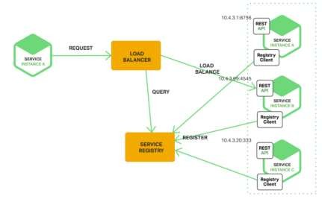
Client vs Server side Service discovery
Client Discovery
Server Discovery
Pictures from https://www.nginx.com/blog/service-discovery-in-a-microservices- architecture/
Client talks to Service registry and does load balancing.
Client service needs to be Service registry aware.
Eg: Netflix OSS
Client talks to load balancer and load balancer talks to Service registry.
Client service need not be Service registry aware
Eg: Consul, AWS ELB

Slide 5
Service Discovery Components
Service Registry – Maintains a database of services and provides an external API(HTTP/DNS) to interact. Typically Implemented as a distributed key, value store
Registrator – Registers services dynamically to Service registry by listening to Service creation and deletion events
Health checker – Monitors Service health dynamically and updates Service registry appropriately
Load balancer – Distribute traffic destined for the service to active participants

Slide 6
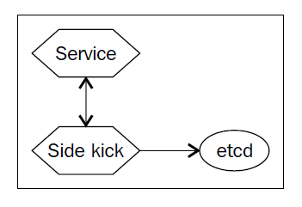
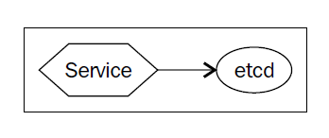
Service discovery using etcd
Etcd can be used as KV store for Service registry.
Service itself can directly update etcd or a Sidekick service can be used to update etcd on the Service details.
Sidekick service serves as registrator.
Other services can query etcd database to do the dynamic Service discovery.
Side kick service does the health check for main service.
Simple Discovery
Discovery using Side kick service

Slide 7
Service discovery – etcd example
Apache service:
[Unit]
Description=Apache web server service on port %i
Apache sidekick service:
[Unit]
Description=Apache web server on port %i etcd registration
# Requirements Requires=etcd2.service Requires=docker.service
Requires=apachet-discovery@%i.service
# Requirements Requires=etcd2.service Requires=apachet@%i.service
# Dependency ordering and binding After=etcd2.service After=apachet@%i.service BindsTo=apachet@%i.service
# Dependency ordering After=etcd2.service After=docker.service
Before=apachet-discovery@%i.service
[Service]
# Get CoreOS environmental variables EnvironmentFile=/etc/environment
[Service]
# Let processes take awhile to start up (for first run Docker containers) TimeoutStartSec=0
# Start
## Test whether service is accessible and then register useful information ExecStart=/bin/bash -c '\
while true; do \
curl -f ${COREOS_PUBLIC_IPV4}:%i; \ if [ $? -eq 0 ]; then \
etcdctl set /services/apachet/${COREOS_PUBLIC_IPV4} \'{"host": "%H",
"ipv4_addr": ${COREOS_PUBLIC_IPV4}, "port": %i}\' --ttl 30; \ else \
etcdctl rm /services/apachet/${COREOS_PUBLIC_IPV4}; \ fi; \
sleep 20; \ done'
# Change killmode from "control-group" to "none" to let Docker remove # work correctly.
KillMode=none
# Get CoreOS environmental variables
EnvironmentFile=/etc/environment
# Pre-start and Start
## Directives with "=-" are allowed to fail without consequence ExecStartPre=-/usr/bin/docker kill apachet.%i
ExecStartPre=-/usr/bin/docker rm apachet.%i ExecStartPre=/usr/bin/docker pull coreos/apache ExecStart=/usr/bin/docker run --name apachet.%i -p
${COREOS_PUBLIC_IPV4}:%i:80 coreos/apache /usr/sbin/apache2ctl -D FOREGROUND
# Stop
ExecStop=/usr/bin/etcdctl rm /services/apachet/${COREOS_PUBLIC_IPV4}
# Stop
ExecStop=/usr/bin/docker stop apachet.%i
[X-Fleet]
# Schedule on the same machine as the associated Apache service X-ConditionMachineOf=apachet@%i.service

Slide 8
Service discovery – etcd example(contd)
3 node CoreOS cluster:
$ fleetctl list-machines
MACHINE IP METADATA
7a895214... | 172.17.8.103 | -
a4562fd1... | 172.17.8.101 | -
d29b1507... | 172.17.8.102 | -
Start 2 instances of the service:
fleetctl start apachet@8080.service apachet-discovery\@8080.service fleetctl start apachet@8081.service apachet-discovery\@8081.service
See running services:
$ fleetctl list-units
UNIT MACHINE
ACTIVE SUB
apachet-discovery@8080.service 7a895214.../172.17.8.103 apachet-discovery@8081.service a4562fd1.../172.17.8.101
active running active running
apachet@8080.service apachet@8081.service
7a895214.../172.17.8.103 a4562fd1.../172.17.8.101
active running active running
Check etcd database:
$ etcdctl ls / --recursive /services
/services/apachet
/services/apachet/172.17.8.103
/services/apachet/172.17.8.101
$ etcdctl get /services/apachet/172.17.8.101
{"host": "core-01", "ipv4_addr": 172.17.8.101, "port": 8081}
$ etcdctl get /services/apachet/172.17.8.103
{"host": "core-03", "ipv4_addr": 172.17.8.103, "port": 8080}

Slide 9
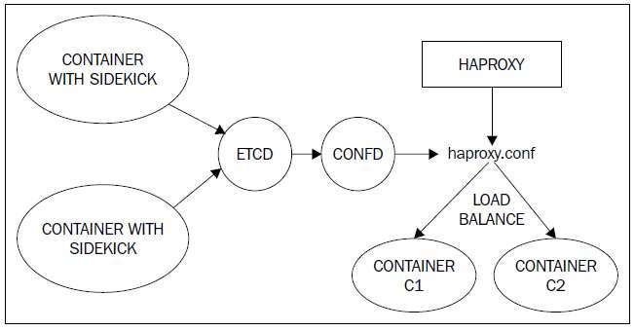
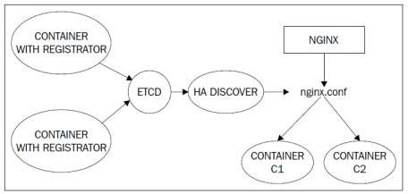
Etcd with Load balancing
Previous example with etcd demonstrates Service database and health check. It does not achieve DNS and Load balancing.
Load balancing can be achieved by combining etcd with confd or haproxy.
Etcd with confd
Etcd with haproxy
Reference: https://www.digitalocean.com/community/tutorials/how-to- use-confd-and-etcd-to-dynamically-reconfigure-services-in- coreos
Reference: http://adetante.github.io/articles/service- discovery-haproxy/

Slide 10
Consul
Has a distributed key value store for storing Service database.
Provides comprehensive service health checking using both in-built solutions as well as user provided custom solutions.
Provides REST based HTTP api for external interaction.
Service database can be queried using DNS.
Does dynamic load balancing.
Supports single data center and can be scaled to support multiple data centers.
Integrates well with Docker.
Consul integrates well with other Hashicorp tools.

Slide 11
Consul health check options
Following are the options that Consul provides for health-check:
Script based check - User provided script is run periodically to verify health of the service.
HTTP based check – Periodic HTTP based check is done to the
service IP and endpoint address.
TCP based check – Periodic TCP based check is done to the service IP and specified port.
TTL based check – Previous schemes are driven from Consul server to the service. In this case, the service is expected to refresh a TTL counter in the Consul server periodically.
Docker Container based check – Health check application is available as a Container and Consul invokes the Container periodically to do the health-check.

Slide 12
Sample application with Consul
Nginx Container1
Ubuntu Container
(http client)
Consul Load balancer,
DNS, Service
registry
Nginx Container2
Two nginx containers will serve as the web servers. ubuntu container will serve as http client.
Consul will load balance the request between two nginx web servers.
Consul will be used as service registry, load balancer, health checker as well as DNS server for this application.

Slide 13
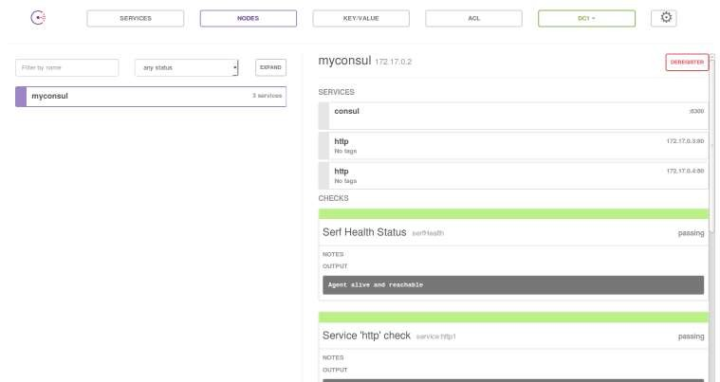
Consul web Interface
Following picture shows Consul GUI with:
2 instances of “http” service and 1 instance of “consul” service.
Health check is passing for both services

Slide 14
Consul with manual registration
Service files:
http1_checkhttp.json:
{
Service status:
$ curl -s http://localhost:8500/v1/health/checks/http | jq . [
{
"ModifyIndex": 424,
"CreateIndex": 423, "Node": "myconsul", "CheckID": "service:http1",
"Name": "Service 'http' check", "Status": "passing",
"Notes": "",
"Output": "", "ServiceID": "http1", "ServiceName": "http"
},
{
"ModifyIndex": 427,
"CreateIndex": 425, "Node": "myconsul", "CheckID": "service:http2",
"Name": "Service 'http' check",
"Status": "passing",
"Notes": "",
"Output": "", "ServiceID": "http2", "ServiceName": "http"
}
]
"ID": "http1",
"Name": "http",
"Address": "172.17.0.3",
"Port": 80,
"check": {
"http": "http://172.17.0.3:80", "interval": "10s",
"timeout": "1s"
}
}
http2_checkhttp.json:
{
"ID": "http2",
"Name": "http", "Address": "172.17.0.4",
"Port": 80,
"check": {
"http": "http://172.17.0.4:80", "interval": "10s",
"timeout": "1s"
}
}
Register services:
curl -X PUT --data-binary @http1_checkhttp.json http://localhost:8500/v1/agent/service/register curl -X PUT --data-binary @http2_checkhttp.json http://localhost:8500/v1/agent/service/register

Slide 15
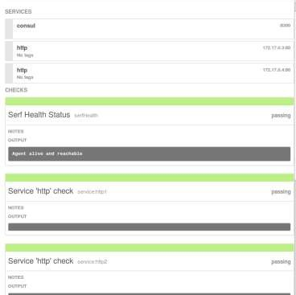
Consul health check – Good status
dig @172.17.0.1 http.service.consul SRV
; <<>> DiG 9.9.5-3ubuntu0.7-Ubuntu <<>> @172.17.0.1 http.service.consul SRV
; (1 server found)
;; global options: +cmd
;; Got answer:
;; ->>HEADER<<- opcode: QUERY, status: NOERROR, id: 34138
;; flags: qr aa rd; QUERY: 1, ANSWER: 2, AUTHORITY: 0, ADDITIONAL: 2
;; WARNING: recursion requested but not available
;; QUESTION SECTION: ;http.service.consul. |  | IN | SRV
;; ANSWER SECTION: http.service.consul. | 0 | IN | SRV 1 1
80 myconsul.node.dc1.consul. http.service.consul. 0 IN SRV 1 1
80 myconsul.node.dc1.consul.
;; ADDITIONAL SECTION: myconsul.node.dc1.consul. 0 IN |  | A | 172.17.0.4
myconsul.node.dc1.consul. 0 IN |  | A | 172.17.0.3

Slide 16
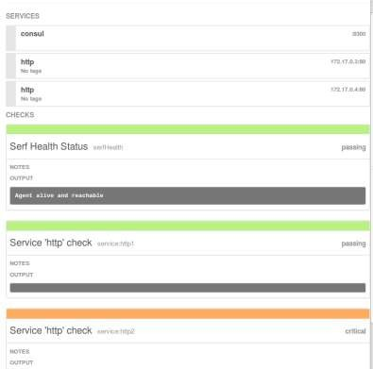
Consul health Check – Bad status
$ dig @172.17.0.1 http.service.consul SRV
; <<>> DiG 9.9.5-3ubuntu0.7-Ubuntu <<>> @172.17.0.1
http.service.consul SRV
; (1 server found)
;; global options: +cmd
;; Got answer:
;; ->>HEADER<<- opcode: QUERY, status: NOERROR, id: 23330
;; flags: qr aa rd; QUERY: 1, ANSWER: 1, AUTHORITY: 0, ADDITIONAL: 1
;; WARNING: recursion requested but not available
;; QUESTION SECTION: ;http.service.consul. |  | IN | SRV
;; ANSWER SECTION: http.service.consul. | 0 | IN | SRV
1 1 80 myconsul.node.dc1.consul.
;; ADDITIONAL SECTION:
myconsul.node.dc1.consul. 0 IN
172.17.0.3
A

Slide 17
Consul with Registrator
Manual registration of service details to Consul is error-prone.
Gliderlabs Registrator open source project (https://github.com/gliderlabs/registrator) takes care of automatically registering/deregistering the service by listening to Docker events and updating Consul registry.
Choosing the Service IP address for the registration is critical. There are 2 choices:
With internal IP option, Container IP and port number gets registered with Consul. This approach is useful when we want to access the service registry from within a Container. Following is an example of starting Registrator using "internal" IP option.
docker run -d -v /var/run/docker.sock:/tmp/docker.sock --net=host gliderlabs/registrator -internal consul://localhost:8500
With external IP option, host IP and port number gets registered with Consul. Its necessary to specify IP address manually. If its not specified, loopback address gets registered. Following is an example of starting Registrator using "external" IP option.
docker run -d -v /var/run/docker.sock:/tmp/docker.sock gliderlabs/registrator -ip 192.168.99.100 consul://192.168.99.100:8500
Following is an example for registering “http” service with 2 nginx servers using HTTP check:
docker run -d -p :80 -e "SERVICE_80_NAME=http" -e "SERVICE_80_ID=http1" -e "SERVICE_80_CHECK_HTTP=true" -e "SERVICE_80_CHECK_HTTP=/" --name=nginx1 nginx
docker run -d -p :80 -e "SERVICE_80_NAME=http" -e "SERVICE_80_ID=http2" -e "SERVICE_80_CHECK_HTTP=true" -e "SERVICE_80_CHECK_HTTP=/" --name=nginx2 nginx
Following is an example for registering “http” service with 2 nginx servers using TTL check:
– docker run -d -p :80 -e "SERVICE_80_NAME=http" -e "SERVICE_80_ID=http1" -e "SERVICE_80_CHECK_TTL=30s" --name=nginx1 nginx
docker run -d -p :80 -e "SERVICE_80_NAME=http" -e "SERVICE_80_ID=http2" -e "SERVICE_80_CHECK_TTL=30s" --name=nginx2 nginx
–

Slide 18
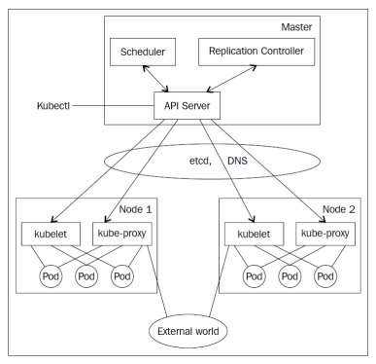
Kubernetes Architecture
Kubernetes Service discovery components:
SkyDNS is used to map Service name to IP address.
Etcd is used as KV store for Service database.
Kubelet does the health check and replication controller takes care of maintaining Pod count.
Kube-proxy takes care of load balancing traffic to the individual pods.

Slide 19
Kubernetes Service
Service is a L3 routable object with IP address and port number.
Service gets mapped to pods using selector labels. In example on
right, “MyApp” is the label.
Service port gets mapped to targetPort in the pod.
Kubernetes supports head-less services. In this case, service is not allocated an IP address, this allows for user to choose their own service registration option.
{
"kind": "Service",
"apiVersion": "v1", "metadata": {
"name": "my-service"
},
"spec": {
"selector": {
"app": "MyApp"
},
"ports": [
{
"protocol": "TCP", "port": 80,
"targetPort": 9376
}
]
}
}

Slide 20
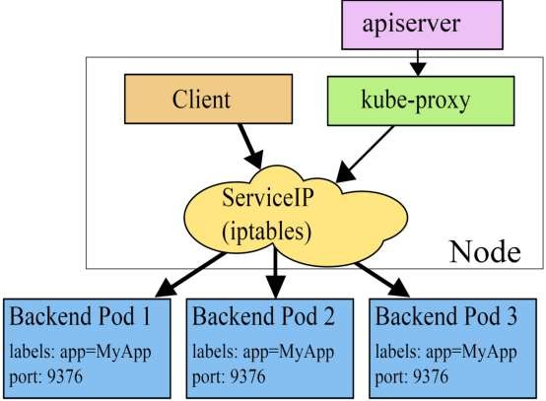
Kubernetes Service discovery Internals
Picture source: http://kubernetes.io/docs/use r-guide/services/
Service name gets mapped to Virtual IP and port using Skydns.
Kube-proxy watches Service changes and updates IPtables. Virtual IP to Service IP, port remapping is achieved using IP tables.
Kubernetes does not use DNS based load balancing to avoid some of the known
issues associated with it.

Slide 21
Kubernetes Health check
Kubelet can implement a health check to check if Container is healthy.
Kubelet will kill the Container if it is not healthy. Replication controller would take care of maintaining endpoint count.
Health check is defined in Pod manifest.
Currently, 3 options are supported for health- check:
HTTP Health Checks - The Kubelet will call a web hook. If it returns between 200 and 399, it is considered success, failure otherwise.
Container Exec - The Kubelet will execute a command inside the container. If it exits with status 0 it will be considered a success.
TCP Socket - The Kubelet will attempt to open a socket to the container. If it can establish a connection, the container is considered healthy, if it can’t it is considered a failure.
Pod with HTTP health check:
apiVersion: v1 kind: Pod metadata:
name: pod-with-healthcheck spec:
containers:
- name: nginx image: nginx
# defines the health checking livenessProbe:
# an http probe
httpGet:
path: /_status/healthz port: 80
# length of time to wait for a pod to initialize # after pod startup, before applying health
checking
initialDelaySeconds: 30
timeoutSeconds: 1
ports:
- containerPort: 80

Slide 22
Kubernetes Service Discovery options
REDIS_MASTER_SERVICE_HOST=10.0.0.11
For internal service discovery, Kubernetes provides two options:
Environment variable: When a new Pod is created, environment variables from older services can be imported. This allows services to talk to each other. This approach enforces ordering in service creation.
DNS: Every service registers to the DNS service; using this, new services can find and talk to other services. Kubernetes provides the kube-dns service for this.
For external service discovery, Kubernetes provides two options:
REDIS_MASTER_SERVICE_PORT=6379 REDIS_MASTER_PORT=tcp://10.0.0.11:63 79 REDIS_MASTER_PORT_6379_TCP=tcp://1 0.0.0.11:6379 REDIS_MASTER_PORT_6379_TCP_PROTO
=tcp REDIS_MASTER_PORT_6379_TCP_PORT= 6379 REDIS_MASTER_PORT_6379_TCP_ADDR= 10.0.0.11
apiVersion: v1 kind: Service metadata:
name: frontend labels:
app: guestbook tier: frontend
spec:
# if your cluster supports it, uncomment the following to automatically create
# an external load-balanced IP for the frontend service.
type: LoadBalancer ports:
# the port that this service should serve on
- port: 80 selector:
app: guestbook tier: frontend
NodePort: In this method, Kubernetes exposes the service through special ports (30000-32767) of the node IP address.
Loadbalancer: In this method, Kubernetes interacts with the cloud provider to create a load balancer that redirects the traffic to the Pods. This approach is currently available with GCE.

Slide 23
Docker Service Discovery
With Docker 1.9, Container name to IP address mapping was done by updating “/etc/hosts” automatically.
With Docker 1.10 release, Docker added embedded DNS server which does Container name resolution within a user defined network.
Name resolution can be done for Container name(-- name), network alias(--net-alias) and Container link(--link). Port number is not part of DNS.
With Docker 1.11 release, Docker added DNS based random load balancing for Containers with same network alias.
Docker’s Service Discovery is very primitive and it does not have health check and comprehensive load balancing.

Slide 24
Docker DNS in release 1.11
Create 3 Containers in “fe” network: docker run -d --name=nginx1 -- net=fe --net-alias=nginxnet nginx
docker run -d --name=nginx2 -- net=fe --net-alias=nginxnet nginx
docker run -ti --name=myubuntu -- net=fe --link=nginx1:nginx1link -- link=nginx2:nginx2link ubuntu bash
DNS by network alias:
root@4d2d6e34120d:/# ping -c1 nginxnet
PING nginxnet (172.20.0.3) 56(84) bytes of data.
64 bytes from nginx2.fe (172.20.0.3): icmp_seq=1 ttl=64 time=0.852 ms
root@4d2d6e34120d:/# ping -c1 nginxnet
PING nginxnet (172.20.0.2) 56(84) bytes of data.
64 bytes from nginx1.fe (172.20.0.2): icmp_seq=1 ttl=64 time=0.244 ms
DNS by link name:
DNS by Container name:
root@4d2d6e34120d:/# ping -c1 nginx1
PING nginx1 (172.20.0.2) 56(84) bytes of data.
64 bytes from nginx1.fe (172.20.0.2): icmp_seq=1 ttl=64
time=0.112 ms
root@4d2d6e34120d:/# ping -c1 nginx2
PING nginx2 (172.20.0.3) 56(84) bytes of data.
64 bytes from nginx2.fe (172.20.0.3): icmp_seq=1 ttl=64 time=0.090 ms
root@4d2d6e34120d:/# ping -c1 nginx1link
PING nginx1link (172.20.0.2) 56(84) bytes of data.
64 bytes from nginx1.fe (172.20.0.2): icmp_seq=1 ttl=64
time=0.049 ms
root@4d2d6e34120d:/# ping -c1 nginx2link
PING nginx2link (172.20.0.3) 56(84) bytes of data.
64 bytes from nginx2.fe (172.20.0.3): icmp_seq=1 ttl=64 time=0.253 ms

Slide 25
References
https://www.nginx.com/blog/service-discovery-in-a-microservices- architecture/
http://jasonwilder.com/blog/2014/02/04/service-discovery-in-the- cloud/
http://progrium.com/blog/2014/07/29/understanding-modern-service-
discovery-with-docker/
http://artplustech.com/docker-consul-dns-registrator/
https://jlordiales.me/2015/01/23/docker-consul/
Mastering CoreOS book - https://www.packtpub.com/networking-and-
servers/mastering-coreos
Kubernetes Services - http://kubernetes.io/docs/user-guide/services/
Docker DNS Server - https://docs.docker.com/engine/userguide/networking/configure-dns/, https://github.com/docker/libnetwork/pull/974

